Slide 1
Looping statements in C for, while and do while
DSA-I
2020
SY(COMP)
COEP
(Ashwini Matange & Shrida Kalamkar)

Slide 2
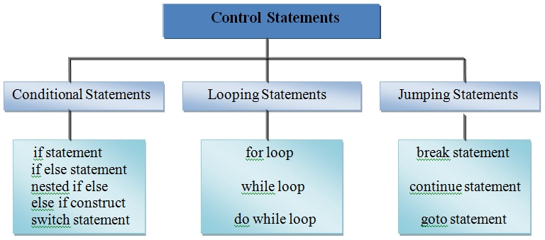

Slide 3
The Loop Control Structure
So far we have used either a sequential or a decision control instruction. ( if –else, switch – case)
the executions were carried out in a fixed order
an appropriate set of instructions were executed depending upon the outcome of the condition being tested Exactly once
The versatility of the computer lies in its ability to perform a set of instructions repeatedly.
This involves repeating some portion of the program either a specified number of times or until a particular condition is being satisfied.
This repetitive operation is done through a loop control instruction.

Slide 4
The Loop Control Structure
Every programming language has the feature to instruct to do such repetitive tasks with the help of certain form of statements.
The process of repeatedly executing a collection of statement is called looping.
The statements gets executed many number of times based on the condition.
But if the condition is given in such a logic that the repetition continues any number of times with no fixed condition to stop looping those statements, then this type of looping is called infinite looping.

Slide 5
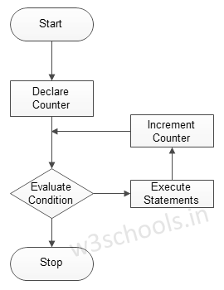
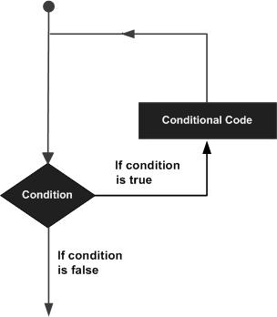
The Loop Control Structure
A loop statement allows us to execute a statement or group of statements multiple times.
Figure – Flowchart of Looping

Slide 6
Branching
Loops
vs
Condition
Statement
list
Condition
T
T
Statement
list
F
F

Slide 7
Types of Loop
There are three methods by way of which we can repeat a part of a program. They are:
(a) Using a for statement
(b) Using a while statement
(c) Using a do-while statement
It is often the case in programming that you want to do something a fixed number of times
Ex. calculate gross salaries of ten different persons,
Ex. Convert temperatures from centigrade to Fahrenheit for 15 different cities.

Slide 8
The for loop
The for allows us to specify three things about a loop in a single line:
Setting a loop counter to an initial value.
Testing the loop counter to determine whether its value has reached the number of repetitions desired.
Increasing the value of loop counter each time the program segment within the loop has been executed.
The general format for a for loop
for(Initialization_action; Condition; Condition_update){
statement_list;
}

Slide 9
The for Loop
The syntax of a for loop in C programming language is −
for ( init; condition; increment ) {
statement(s);
}

Slide 10
The for Loop : flow of control
1 . The init step is executed first, and only once.
This step allows you to declare and initialize any loop control variables.
2. Next, the condition is evaluated.
If it is true, the body of the loop is executed.
If it is false, the body of the loop does not execute and the flow of control jumps to the next statement just after the 'for' loop.
3. After the body of the 'for' loop executes, the flow of control jumps back up to the increment/modication statement.
This statement allows you to update any loop control variables.
4. The condition is now evaluated again. If it is true, the loop executes and the process repeats itself (body of loop, then increment step, and then again condition). After the condition becomes false, the 'for' loop terminates.

Slide 11
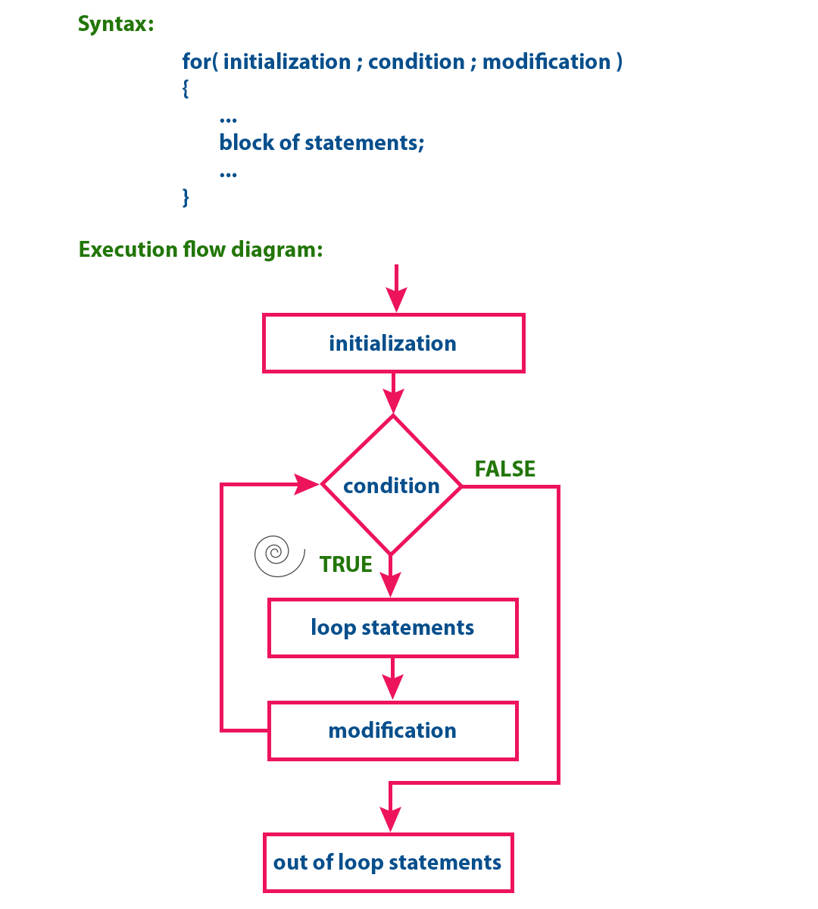
Working of for loop in C
1 | int main() {
2 | int i, sum = 0;
3 | for(i = 0; i < 11; i++) {
4 | printf(“%d”, i);
5 | sum = sum + i;
6 | }
7 | printf(“%d”, sum);
8 | return 0;
9 | }

Slide 12
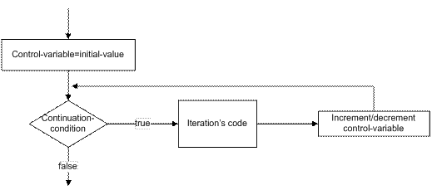
The for loop
for(control-variable initialization; continuation condition; increment/decrement-control variable ) {
// body of loop
}
e
}

Slide 13
Code to display integers from 1 -10
#include<stdio.h>
int main() {
int i;
for(i = 1; i <= 10; i++)
printf("%d\n", i);
}
Note: The curly brackets { } , can be skipped if the for loop has only 1 statement.
If the brackets are missing then ONLY very next statement will be iterated

Slide 14
Try following now:
1 Print numbers from 10 to 1
2 Print numbers from n to m. n and m are accepted from user.
3 Print all numbers divisible by ‘n’ , between 1 to 1000. ‘n’ accepted from user
4 Print sum of numbers from 1 to 10
5. Print Alphabets from A – Z, a- z, z-a, Z-A

Slide 15
Print alphabets from ‘A’ – ‘Z’
include<stdio.h>
int main() {
char i;
for(i = 'A'; i <= 'Z'; i++) {
printf("%c\n", i);
}
return 0;
}

Slide 16
What will be the output?
include<stdio.h>
int main() {
char i;
for(i = 'A'; i <= 'Z'; i++) {
printf("%d\n", i);
}
return 0;
}
OUTPUT?
*NOTE THE CHANGE*

Slide 17
Example 1: For – Simple interest
/* Calculation of simple interest for 3 sets of p, n and r */
void main ( ) {
int p, t, count ;
float r, si ;
for ( count = 1 ; count <= 3 ; count = count + 1 ) {
printf ( "Enter values of p, t, and r " ) ;
scanf ( "%d %d %f", &p, &t, &r ) ;
si = p * n * r / 100 ;
printf ( "Simple Interest = Rs.%f\n", si ) ;
}
}

Slide 18
Example 2: For - Factorial
Factorial of n is n*(n-1)*(n-2)*...2*1
int i, n, f=1;
printf(“Enter a number to find factorial”);
scanf(“%d”,&n);
for (i=1; i<=n; ++i) {
f = f* i;
}
printf(“The factorial of %d is %d ”,n,f);

Slide 19
Additional features of for loop
The comma operator
We can give several statements separated by commas in place of “Initialization”, “condition”, and “updating”.
Example
for (fact=1, i=1; i<=10; i++)
fact = fact * i;
for (sum=0, i=1; i<=N; ++i)
sum = sum + i * i;

Slide 20
We can use expression in assignment statements of initialization and update section
Example:
for( x = ( m + n ) / 2 ; x > 0 ; x = x/2 )
We can omit one or more sections
Example:
int m=5;
for ( ; m != 100 ; ) {
statements;
m = m + 5 ;
}

Slide 21
for(expr1; expr2; expr3)
Most commonly, expr1 and expr3 are assignments or function calls and expr2 is a relational expression.
Any of the three parts can be omitted, although the semicolons must remain.
If expr1 or expr3 is omitted, it is simply dropped from the expansion.
If the test, expr2, is not present, it is taken as permanently true

Slide 22
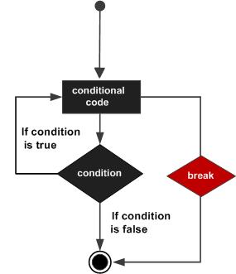
Break Statement in C
Break statement are used for terminates any type of loop e.g, while loop, do while loop or for loop.
The break statement terminates the loop body immediately and passes control to the next statement after the loop.
In case of inner loops, it terminates the control of inner loop only.

Slide 23
Continue Statement in C
The continue statement in C programming works somewhat like the break statement.
Instead of forcing termination, it forces the next iteration of the loop to take place, skipping any code in between.
In a for loop, it will force the program to update (increment or decrement) the loop variable and then check the condition immediately.
For the while and do...while loops, continue statement causes the program control to pass to the conditional tests.

Slide 24
Continue in a loop
The continue statement in a loop will force the program to check the loop condition immediately.
do {
printf(“Will you pass this exam?”);
scanf(“%c”,&ans);
if (and != ‘Y’ && ans != ‘y’) continue;
printf(“Great?”);
break;
} while (true);
....
24

Slide 25
break/ continue
int i = 0;
for(; ;) {
if(i > 10)
break;
else
continue;
printf(“%d”, i);
i = i +1;
}
int i = 0;
for(; i <= 10;) {
printf(“%d”, i);
i = i +1;
}
int i = 0;
for(; ; i =i + 1) {
if(i > 10)
break;
else
continue;
printf(“%d”, i);
}

Slide 26
Write a code to keep accepting numbers and adding them till the sum exceeds 100
include<stdio.h>
int main() {
int i, sum,n;
for(i = 1, sum = 0; ; i++){
scanf("%d", &n);
sum += n;
if(sum <= 100)
continue;
else
break;
}
printf("Total numbers read = %d\nSum = %d", i, sum);
}

Slide 27
Nested loops (loop in a loop)
The syntax for a nested for loop statement in C is as follows −
for (init; condition; increment) {
for (init; condition; increment) {
statement(s);
}
statement(s);
}
27

Slide 28
Nested loops (loop in a loop)
In Nested loop one loop is place within another loop body.
When we need to repeated loop body itself n number of times use nested loops.
Nested loops can be design upto 255 blocks.
printf(“%d%d”,a,b); //a=4,b=7
for (i = 0; i < a; i++){
for (j=0; j<b; j++) {
printf(“*”);
}
printf(“\n”);
}
b
*******
*******
*******
*******
a
28

Slide 29
Nested loops example
b
*
**
***
****
int a,b;
Printf(“Enter two values”);
scanf(“%d%d”,&a,&b);
for (i = 0; i < a; i++) {
for (j = 0; j < b; j++) {
if (j > i)
break;
printf(“*”);
}
printf(“\n”);
}
a

Slide 30
Nested loops example
int a,b;
scanf(“%d%d”,&a,&b);
for (int i = 0; i < a; i++) {
for (int j=0; j<b; j++) {
if (j < i)
printf(“ ”);
else
printf(“*”);
}
printf(“\n”);
}
b
*************
************
***********
**********
a

Slide 31
Nested loops example
int a,i,j;
scanf(“%d”,a);
for (i = 0; i < a; i++) {
for (j=0; j<a; j++) {
if (j < a-i)
printf(" ");
else printf("*");
}
for (j=0; j<a; j++) {
if (j > i)
break;
printf("*");
}
printf(“\n”);
}
*
***
*****
*******
*********
***********

Slide 32
Comparison with Python ‘for’
#Syntax of for statement in Python
for i in range(start, stop, step):
statement1
statement2
# Example of for loop in Python
for i in range(1, 11, 1):
print(i)
/* C Code Segment*/
int start , stop = 11, step = 1;
for(start = 1; start < stop; start = start +1)
printf(“%d”, start);

Slide 33
Syntax:
for(initialization; condition; modification) {
---
block of statements
---
}
for(expr1; expr2; expr3) {
}
Grammatically, the three components of a for loop are expressions

Slide 34
Empty and infinite loop
for (; ; );
for (i = 0; i < 100000; i++);
for (i = 1; i > 0; i++) {
loop body
}

Slide 35
Write C Program using for loop:
Write a C program to find factorial
Write a C Program to reverse a given number. (For e.g., user entered 54823 so its reverse is 32845)
Write a C Program to find product of digits of a number. (For e.g., user entered 2534, product of digits is 2 x 5 x 3 x 4 = 120 and user should not enter 0 as a digit
Sum of series :
x + x/1 + x/2! + x/3! …x/n!

Slide 36
Write Code to get the following output:
1
1 2
1 2 3
1 2 3 4
1 2 3 4 5
#include<stdio.h>
int main() {
int i,j;
for(i = 1; i <= 5; i++) {
for(j = 1; j <= i; j++)
printf("%d", j);
printf("\n");
}
return 0;
}

Slide 37
Write Code to get the following output:
1
1 2
1 2 3
1 2 3 4
1 2 3 4 5

Slide 38
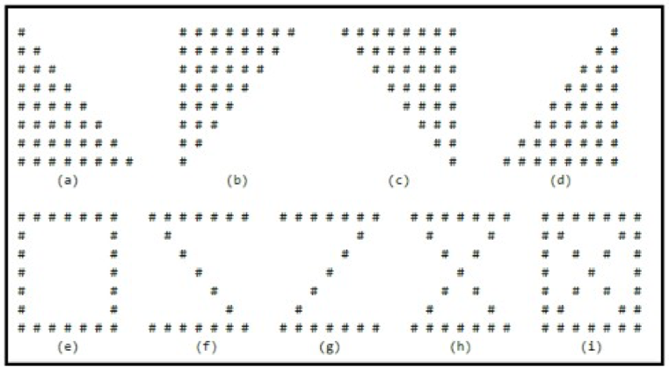
Examples:

